Slide 1
PREDICTIVE ANALYSIS OF TELECOM CHURN FOR OPTIMAL CUSTOMER RETENTION
Presented By-
Piyush Khichi. (233530)
Chaitanya Babu Patil. (233509)

Slide 2
INTRODUCTION
Churn prediction is one of the most popular Big Data use cases in business.It consists of detecting customers who are likely to cancel a subscription to a service
Churn is a problem for telecom companies because it is more expensive to acquire a new customer than to keep your existing one from leaving.

Slide 3
PROJECT OBJECTIVE
To predict Customer Churn.
Highlighting the main factors influencing Customer Churn.
Use various ML algorithms to build prediction models,evaluate the accuracy and performance of these models.
Finding out the best model for our business case and providing executive summary

Slide 4
CHURN MODEL PREDICTION

Slide 5
DATASET DESCRIPTION
Dataset Format = .csv
No. of Rows = 243553
No. of Columns = 14
There is no missing value for provided dataset.
Churn is a variable which notifies whether a particular customer is churned or not.

Slide 6
EDA (Exploratory Data Analysis)
EDA (Exploratory Data Analysis) helps to uncover patterns,relationships in data, guiding decision-making and shaping subsequent analysis, modeling, and insights.
Library Used :
Seaborn and MatplotLib

Slide 7
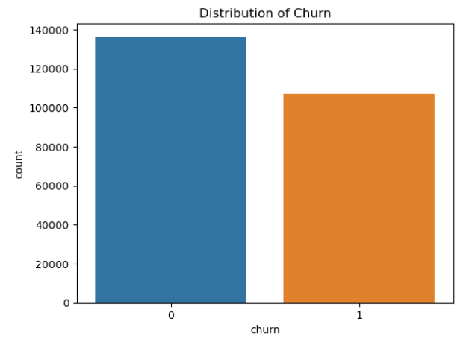
Distribution of the target variable
sns.countplot(x='churn', data=dataset)
plt.title("Distribution of Churn")
plt.show()

Slide 8
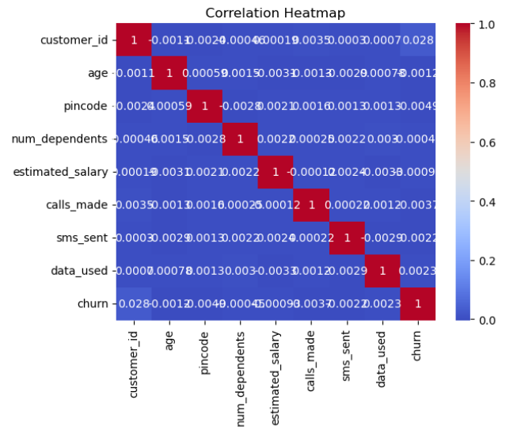
Correlation between numerical features
corr_matrix = dataset.corr()
sns.heatmap(corr_matrix, annot=True, cmap='coolwarm')
plt.title("Correlation Heatmap")
plt.show()

Slide 9
PRE-PROCESSING
One-Hot Encoding
categorical_columns = ['telecom_partner', 'gender', 'state', 'city']
data_encoded = pd.get_dummies(dataset, columns=categorical_columns)
Data Splitting
X = data_encoded.drop('churn', axis=1)
y = data_encoded['churn']
X_train, X_test, y_train, y_test = train_test_split(X, y, test_size=0.2, random_state=42, shuffle=True)

Slide 10
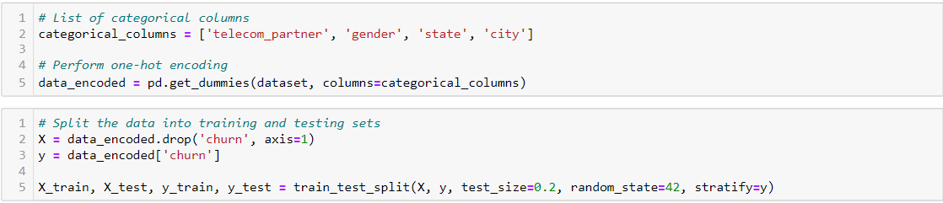
Split Data into Sub-set
One Hot Encoding - A technique used to convert Categorical variables into binary, which makes them suitable for Machine learning Algorithm.

Slide 11
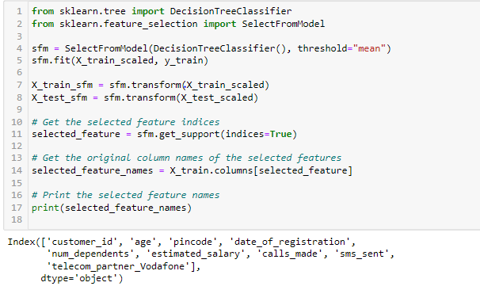
FEATURE SELECTION
Feature selection is the process of choosing a subset of the most important features or variables from a larger set of features in a dataset.
The goal of feature selection is to improve model performance, reduce overfitting, enhance interpretability, and reduce the computational cost of training models.

Slide 12
ALGORITHM USED FOR PREDICTION
Logistic Regression:
Logistic regression is a simple yet effective algorithm for binary classification tasks like churn prediction.
It models the probability of the target class based on input features and is interpretable.
Good for establishing a baseline and understanding feature importance.
Random Forest:
Random Forest is an ensemble algorithm that builds multiple decision trees and combines their predictions.
It handles non-linear relationships well, and it's robust to overfitting.
Provides feature importance scores and is resistant to outliers.

Slide 13
Gradient Boosting:
Gradient Boosting builds an ensemble of weak learners (usually decision trees) in a sequential manner.
It focuses on improving prediction errors of previous models, leading to a strong final model.
Can capture complex relationships in data and has good predictive performance.
XGBoost:
XGBoost is an optimized version of gradient boosting.
It includes regularization terms, which help prevent overfitting.
Often used for structured/tabular data and is known for its speed and performance.
CatBoost:
CatBoost is another gradient boosting variant that handles categorical variables efficiently.
It automatically encodes categorical features and reduces the need for extensive preprocessing.
Can provide good results with minimal hyperparameter tuning.

Slide 14
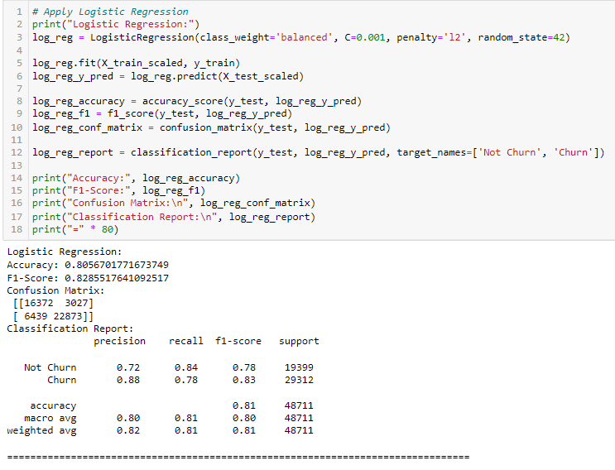
Logistic Regression Model

Slide 15
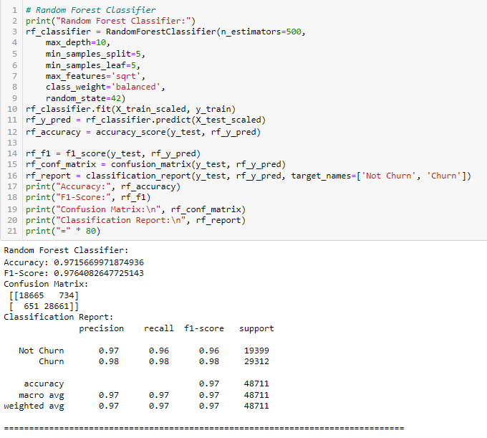
Random Forest Model

Slide 16
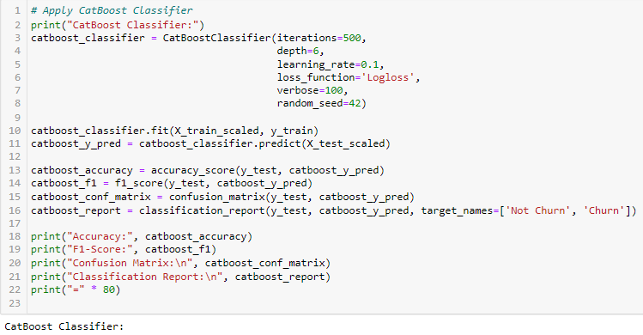
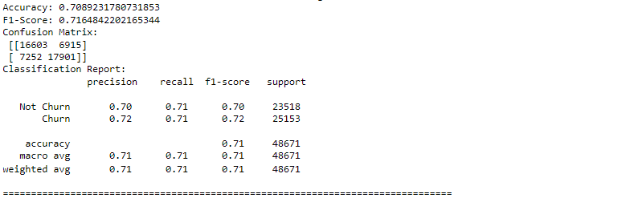
CatBoost Model

Slide 17
Results of ML Model’s
ML Algorithms | Logistic Regression | Random Forest | XGBoost | Gradient Boost | CatBoost
Accuracy | 0.8056701771673749 | 0.9715669971874936 | 0.677362402742707 | 0.6429553899529881 | 0.7089231780731853
F1-Score | 0.8285517641092517 | 0.9764082647725143 | 0.6564508372316706 | 0.5801062288749396 | 0.7164842202165344
Confusion Matrix | [16372 3027] [ 6439 22873] | [18665 734] [ 651 28661] | [17980 1419] [14297 15015] | [19305 94] [17298 12014] | [16603 6915] [ 7252 17901]

Slide 18
FINDINGS AND SUGGESTIONS
Try to offer the better service for the churn customers,see how much this impact before and later .Some may use your service better move them to your active customers.
Take the feedback and suggestions with in period of time and improve it,strive for better communication.
When you are taking the any change in plans of your business just predict the positive and negative share of that plan. If it is negative prepare the solution before so You can handy easily.

Slide 19
HOW TO REDUCE CUSTOMER CHURN
﻿
Lean into your best customers.
Be proactive with communication.
Define a roadmap for your new customers.
Offer incentives.
Ask for feedback often.
Analyze churn when it happens. Stay competitive.

Slide 20
CONCLUSION
The importance of this type of research in the telecom market is to help companies make more profit.
It has become known that predicting churn is one of the most important sources of income to Telecom companies.
Hence, this research aimed to build a system that predicts the churn of customers telecom company.
These prediction models need to achieve high AUC values. To test and train the model, the sample data is divided into 70% for training and 30% for testing.

Slide 21
Thank You!!!

